Slide 1
Zillow’s Home Value Prediction
Team Members:
Yizhen Qiu, Hao Tian, Qianlin Weng
Fangyuan Lian, Simeng Zhao, Chenxi Zhang
Tutor：Dr Mauricio A. Álvarez

Slide 2
Background of the project
01
Zillow Group, Inc., or simply Zillow, is an American online real estate database company that was founded in 2006
In March 2011, Zillow released Rent Zestimates, which provide estimated rent prices for 90 million homes on both the Zillow website and all of its mobile apps
Zillow publishes Zestimate home valuations for 97.5 million homes across the country, and uses millions of statistical and machine learning models that can examine hundreds of data points for each individual home.
02
03
Why is home value predition important ?

Slide 3
Research questions
How to deal with 58 different features in the dataset ?
How to choose the combination of different features ?
What kind of machine learning algorithm can be chosen ?
How to evaluate whether our model meets the requirements ?

Slide 4
Methodology
Delete a feature column where a large part of the feature is a NaN value, or set a default value for some feature data which is NaN value
Consider the correlation between different variables to find important variables.
The preferred algorithm are linear regression, XGBoost, lightGBM.
Calculate mean absolute error

Slide 5
Deliverables for the project
1. Developing an algorithm that makes predictions about the future sale prices of homes.
House price prediction using regression technique
2. Building a model to improve the Zestimate residual error.
“Zestimates” are estimated home values based on 7.5 million statistical and machine learning models that analyze hundreds of data points on each property. And, by continually improving the median margin of error (from 14% at the onset to 5% today)
Submissions are evaluated on Mean Absolute Error between the predicted log error and the actual log error. The log error is defined as
logerror=log(Zestimate)−log(SalePrice)

Slide 6
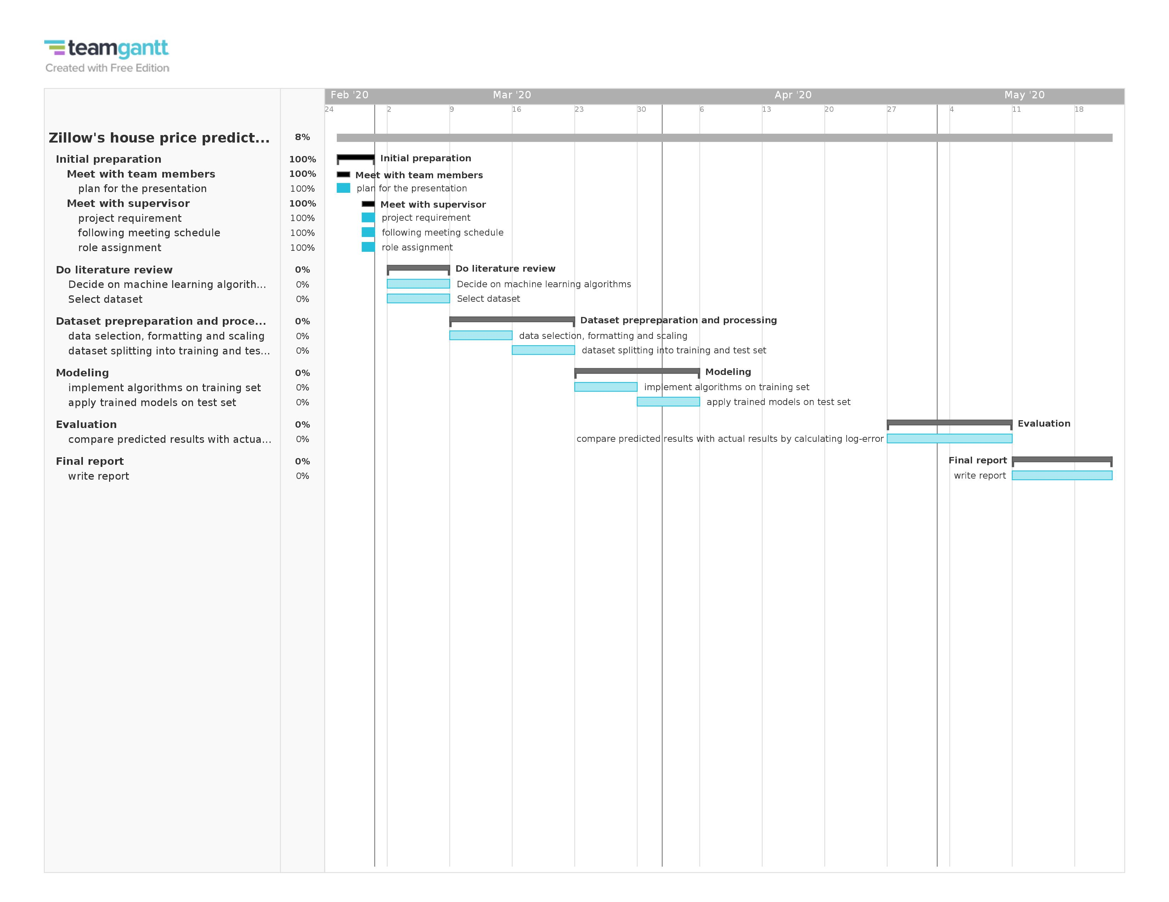
Project Plan

